Slide 1
Young, Gifted and Gay
All will:
Recognise there are black people who are Lesbian, Gay, Bisexual or Trans+
That it is not a new phenomenon
Most will: That many black gay men have been challenging racism as well as homophobia
That poetry and song is a powerful way to educate out prejudice
Some will:
Recognise that this is an example of intersectionality

Slide 2
Homework
Choose and research one of the following people and write a short biography of them: Nicola Adams MBE (1982-) British Boxer and Olympic medallist; Bisi Alimi (1975-), activist and campaigner; first (and so far last) man to come out on Nigerian TV; James Baldwin (1924 – 1987), writer and Civil Rights activist; Angela Davies (1944 – ), Civil Rights activist; Bayard Rustin (1912 – 1987), Civil Rights activist

Slide 3
Listen to Something Inside, by Labi Siffre
https://www.youtube.com/watch?v=xO3Dco5OdqE

Slide 4
Work in small groups
Look at the song lyrics
What does the song mean to you?
What do you feel about the song?

Slide 5
Now read this
British musician Labi Siffre has revealed that he wrote famous Anti-Apartheid anthem ‘Something Inside So Strong’ about his experiences as a gay man.
The singer rose to fame in the 1970s, and is known for penning ‘(Something Inside) So Strong’ while apartheid was in effect in South Africa.
The song was adopted by the anti-apartheid movement as a rallying anthem, for its lyrics including: “The farther you take my rights away the faster I will run/ You can deny me, you can decide to turn your face away.”
However, the singer revealed to the Radio 4’s Today Show that the song was actually inspired by his experiences as a gay men.
From: PinkNews 2015

Slide 6
Discuss
What do you think about it now?
Any surprises ?
Has your opinion of the song changed?

Slide 7
If We Must Die BY CLAUDE MCKAY
If we must die, let it not be like hogs Hunted and penned in an inglorious spot, While round us bark the mad and hungry dogs, Making their mock at our accurséd lot. If we must die, O let us nobly die, So that our precious blood may not be shed In vain; then even the monsters we defy Shall be constrained to honor us though dead!
O, kinsmen! we must meet the common foe! Though far outnumbered let us show us brave, And for their thousand blows deal one death-blow! What though before us lies the open grave? Like men we'll face the murderous, cowardly pack Pressed to the wall, dying, but fighting back!

Slide 8
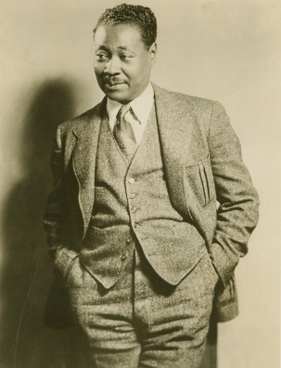
Claude MacKay
Claude McKay was born on September 15, 1889 (to May 22, 1948). The bisexual Jamaican-American writer and poet was part of the ‘Harlem Renaissance’. His poetry was political and often gritty, and he was among the first Harlem Renaissance poets to openly address bisexuality. In 1919, he met Crystal and Max Eastman, who produced “The Liberator.” McKay would serve as co-executive editor of “The Liberator,” and published one of his most famous poems, “If We Must Die.”

Slide 9
Something Inside was released in 1987. If We Must Die was published in 1919.
What are the similarities and differences in the poem/song and the ideas they express?
What differences might be due to the time in which they appeared?
If you had not been told would you have thought the authors were black and gay/bisexual?

Slide 10
Plenary
Write down three things that you have learned today. Compare your answers with others in a group/class

